Slide 1
Introduction to Pandas A PYTHON LIBRARY THAT IS USED FOR DATA MANUPULATION AND ANALYSIS TOOL.

Slide 2
Pandas Introduction
What is Pandas?
Pandas is a Python library used for working with data sets.
It has functions for analyzing, cleaning, exploring, and manipulating data.
The name "Pandas" has a reference to both "Panel Data", and "Python Data Analysis" and was created by Wes McKinney in 2008.
Why Use Pandas?
Pandas allows us to analyze big data and make conclusions based on statistical theories.
Pandas can clean messy data sets, and make them readable and relevant.
Relevant data is very important in data science.

Slide 3
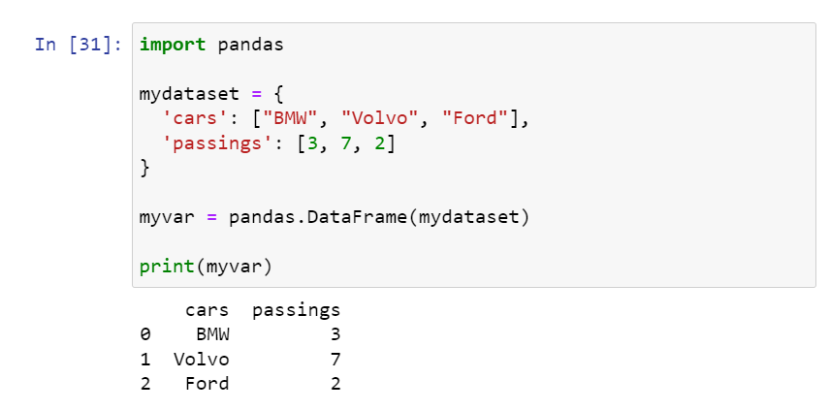
Pandas Basics
Import Pandas
Once pandas is installed ,import it in your application using the import keyword
Import pandas
Now Pandas is imported and ready to use
Example

Slide 4

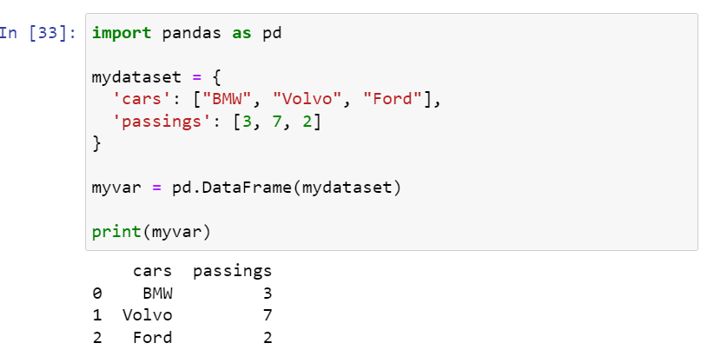
Pandas as pd
Pandas is usually imported under the pd alias.
Alias : In Python alias are an alternate name for referring to the same thing.
Now the pandas can be referred as pd instead of pandas

Slide 5
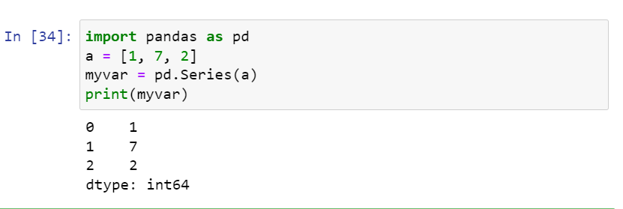
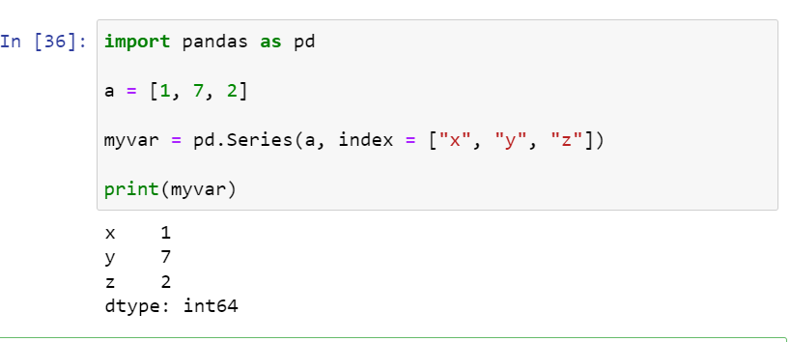
Pandas Series
What is a Series?
A Pandas Series is like a column in a table.
It is a one-dimensional array holding data of any type.
Create Labels
With the index argument ,
you can name your own labels.

Slide 6
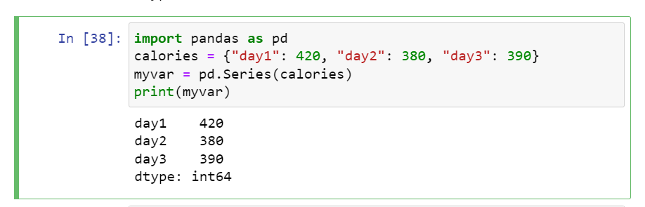
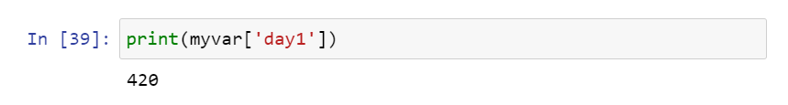
Key/Value Objects as Series
You can also use a key/value object, like a dictionary, when creating a Series.
The keys of the dictionary become the labels.

Slide 7
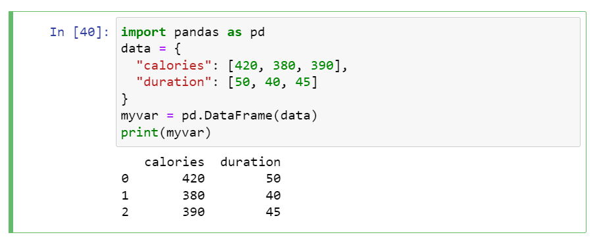
DataFrames
What is a DataFrame?
A Pandas DataFrame is a 2 dimensional data structure, like a 2 dimensional array, or a table with rows and columns.
Data sets in Pandas are usually multi-dimensional tables, called DataFrames.
Series is like a column, a DataFrame is the whole table.
Creating a DataFrame from two Series:

Slide 8
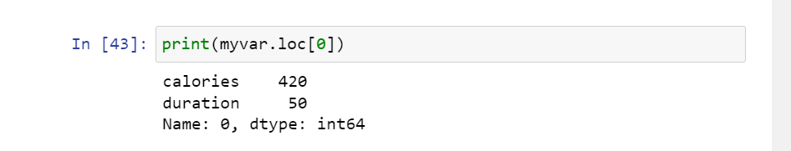
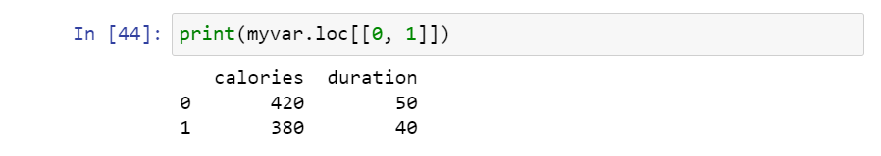
Locating a row
As seen in the result above , the dataframe is like a table with rows and columns.
Pandas use the loc attribute to return one or more specified rows.
This example returns a Pandas Series.
When using[] , the result is a Pandas DataFrame.

Slide 9
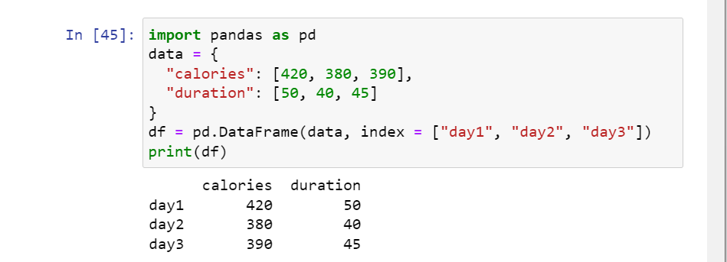
Named Indexes
With the index argument , we can name our own indexes.

Slide 10
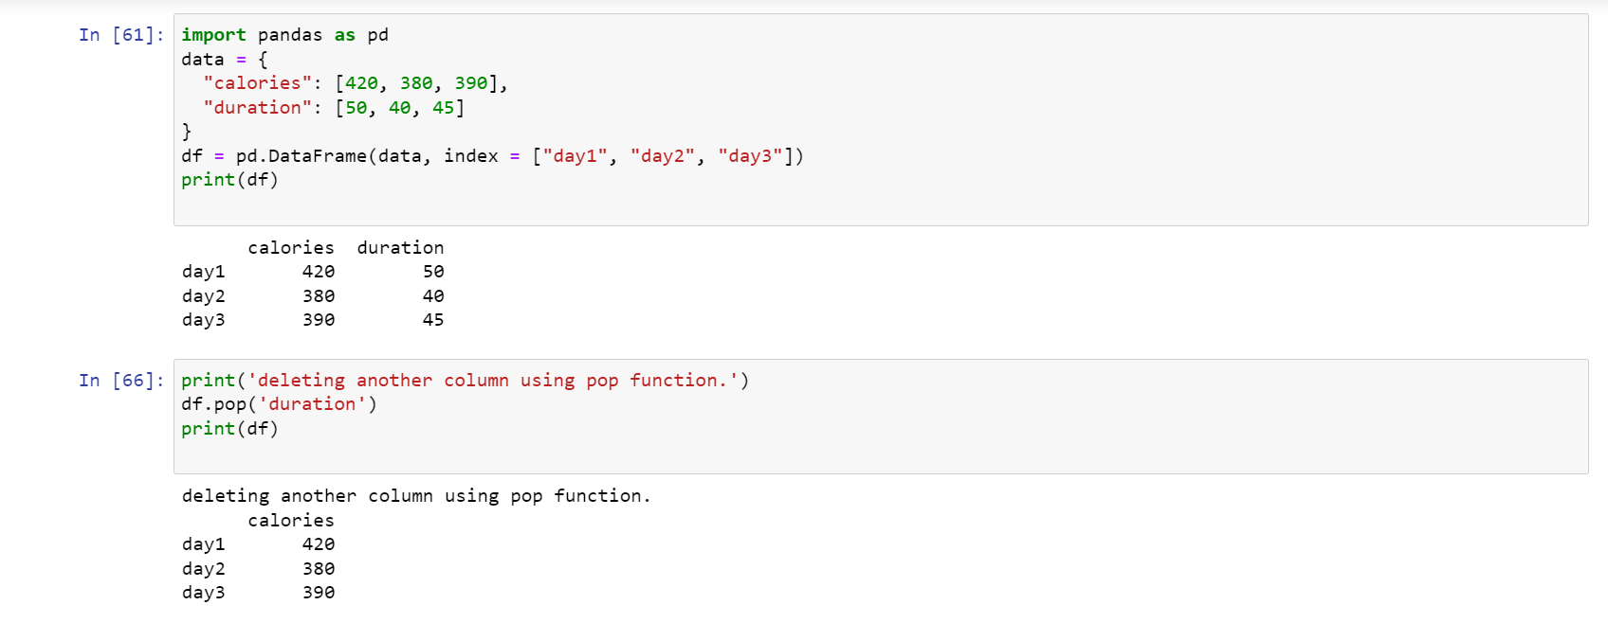
Column deletion

Slide 11
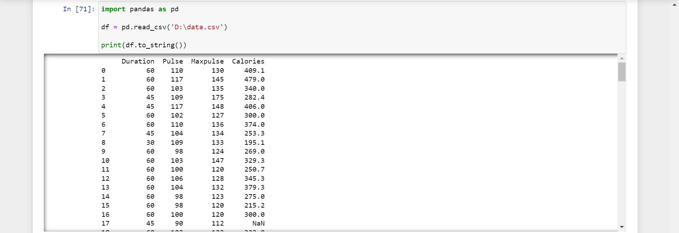
Pandas Read CSV
Read CSV Files
A simple way to store big data sets is to use CSV files (comma separated files).
CSV files contains plain text and is a well know format that can be read by everyone including Pandas.
Use to_string() to print entire DataFrame.

Slide 12
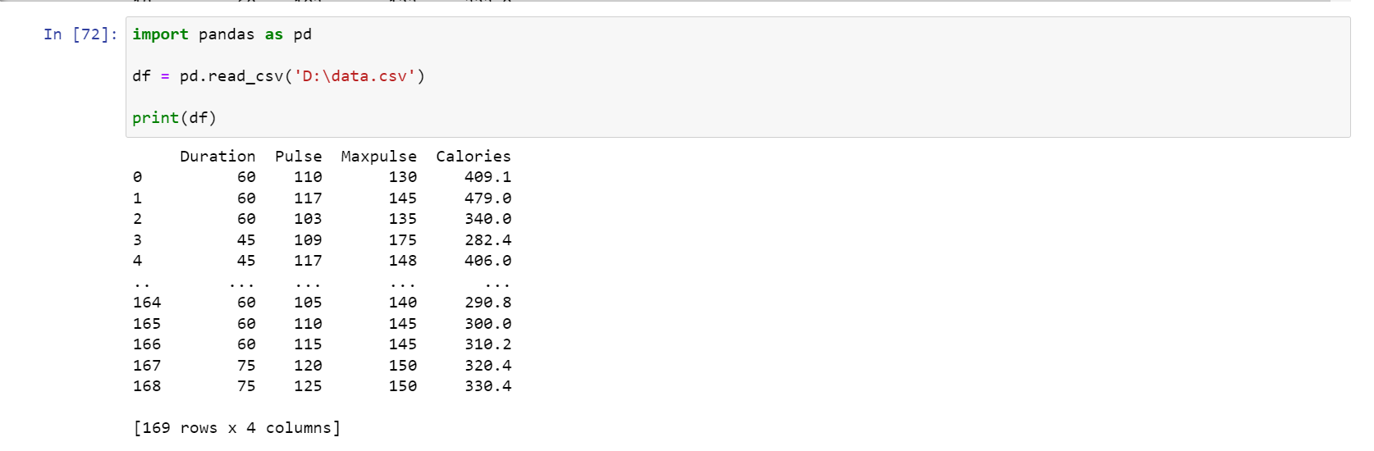
If you have a large DataFrame with many rows, Pandas will only return the first 5 rows, and the last 5 rows:

Slide 13
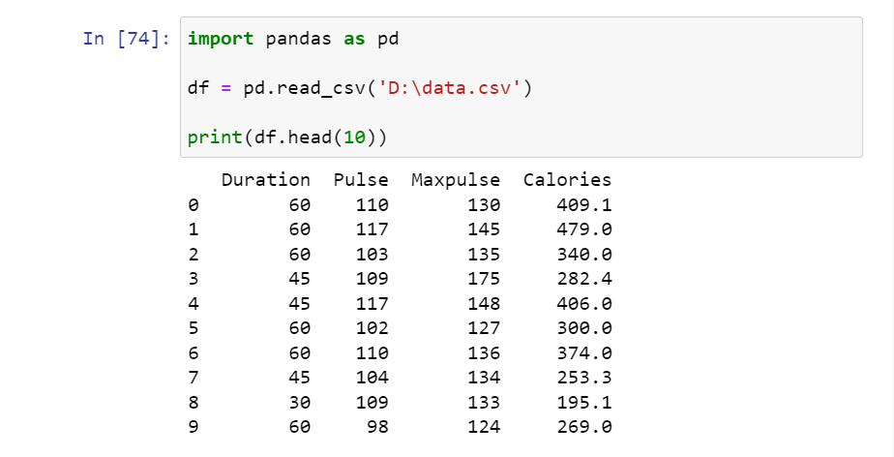
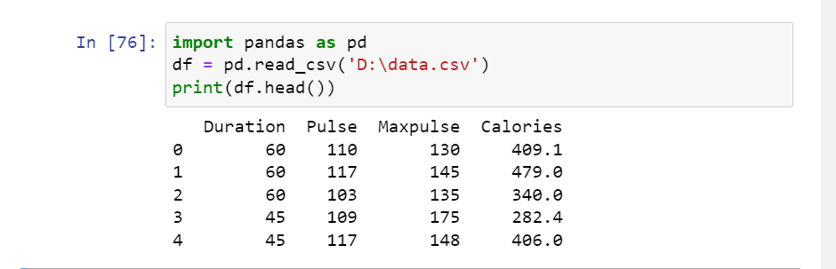
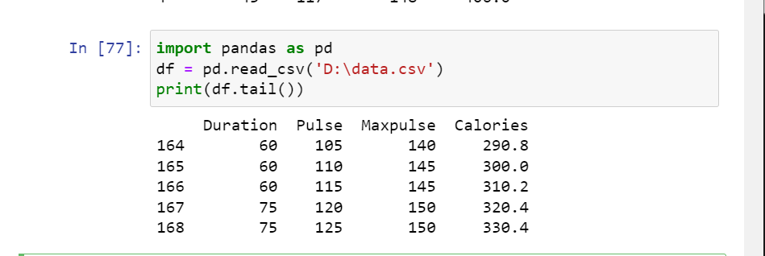
Pandas Analyzing Data
One of the most used method for getting a quick overview of the DataFrame , is the head().
The head() returns the headers and a specified number of rows , starting from the top.
If the number of rows is not specified , the head() method will return the top 5 rows.
There is also a tail method for viewing the last rows of the Dataframe
The tail() method returns the headers and a specified number of rows from the bottom.

Slide 14
Thank You Anil Kumar Vinay Tantry

